Slide 1

Faculty of Economics and Administrative Sciences
Department of Economics
ADM201 History of Political Thought I
Research Assistant Sefa MERTEK

Slide 2

Plato
ADM201 History of Political Thought I
Week 3

Slide 3
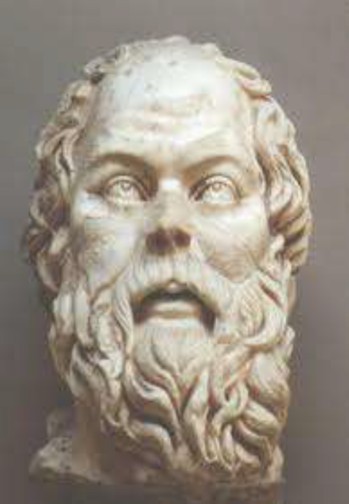
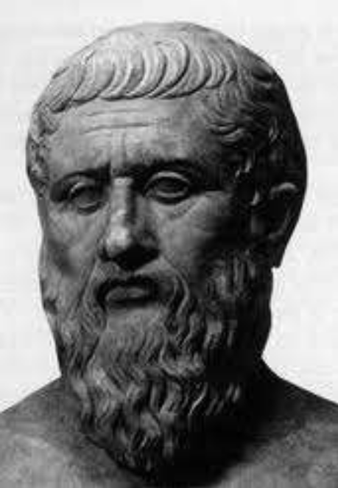
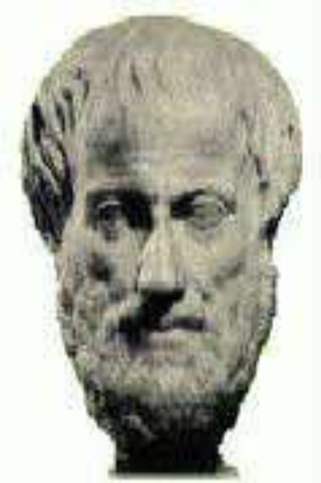
Who is Plato?
Teacher
Teacher

Slide 4
PLATO
A Classical Greek philosopher, mathematician, writer of philosophical dialogues.
Founder of the Academy in Athens, the first institution of higher learning in the Western world.

Slide 5
Along with his mentor, Socrates, and his student, Aristotle, Plato helped to lay the foundations of Western philosophy and science.
Plato was originally a student of Socrates, and was as much influenced by his thinking as by his apparently unjust execution.

Slide 6
I.Early life : 1.Birth and family
2.Name
3. Education
II.Philosophy and main thoughts
III.Works: 1.The Republic
2.The Laws
IV.Major Contribution

Slide 7
Birth and Family
The exact birth-date of Plato is unknown. Based on ancient sources, most modern scholars estimate that he was born in Athens 427 B.C. in a aristocratic and influential family.
His father was Ariston. According to a disputed tradition, Ariston traced his descent from the king of Athens, and the king of Messenia. Plato's mother’s family boasted of a relationship with the famous Athenian lawmaker and lyric poet Solon.

Slide 8
Education
Plato's quickness of mind and modesty as a boy, and the "first fruits of his youth infused with hard work and love of study".
Plato must have been instructed in grammar, music, and gymnastics by the most distinguished teachers of his time.
Plato had also attended courses of philosophy; before meeting Socrates, he first became acquainted with Cratylus (a disciple of Heraclitus, a prominent pre-Socratic Greek philosopher) and the Heraclitean doctrines.

Slide 9
Plato may have traveled in Italy, Egypt to realize his aristocratic political dream. Said to have returned to Athens at the age of forty failed, Plato founded one of the earliest known organized schools on a plot of land in the Grove of Academus in Western Civilization. The Academy was "a large enclosure of ground that was once the property of a citizen at Athens named Academus. Some, however, say that it received its name from an ancient hero", and it operated until AD 529, when it was closed by Justinian I of Byzantium, who saw it as a threat to the propagation of Christianity. Many intellectuals were schooled in the Academy, the most prominent one being Aristotle.

Slide 10
Throughout his life, Plato became entangled with the politics of Syracuse. His main interests lay in Rhetoric, Art, Literature, Epistemology, Justice, Virtue, Politics, Education, Family, Militarism .

Slide 11
Plato Back In ATHENS
When Plato returned to Athens in 387 B.C., he started a school of learning called the Academy, which was eventually described as the 1st European University
At the Academy, he taught his subjects astronomy, biology, mathematics, political theory, and philosophy.

Slide 12
Philosophy
A pupil of Socrates, Plato, too, had a bias against democracy. He had an aristocratic upbringing, and was immersed in the culture of his day, but his plan, abetted by relatives, to enter politics was abandoned after he saw what was done to Socrates.

Slide 13
Plato holds his gestures to the heavens, representing his belief in The Forms.
In several dialogues, Socrates floats the idea that Knowledge is a matter of recollection, and not of learning, observation, or study. He maintains this view somewhat at his own expense, because in many dialogues, Socrates complains of his forgetfulness. Socrates is often found arguing that knowledge is not empirical, and that it comes from divine insight.

Slide 14
In many middle period dialogues, such as the Phaedo, Republic and Phaedrus Plato advocates a belief in the immortality of the soul, and several dialogues end with long speeches imagining the afterlife. More than one dialogue contrasts knowledge and opinion, perception and reality, nature and custom, and body and soul.

Slide 15
Socrates says that poetry is inspired by the muses, and is not rational. He speaks approvingly of this, and other forms of divine madness (drunkenness, eroticism, and dreaming) want to outlaw Homer's great poetry, and laughter as well.

Slide 16
Knowledge is not sense perception, not what simply appears to me.
Like Socrates, Plato believes in “ virtue is knowledge,” and the source of knowledge is virtue. It is not abstract, but concrete knowledge, not theoretical but practical knowledge. A man must know what is good so that he may do good.

Slide 17
Virtue can be taught, and there are four cardinal virtues: wisdom, courage or fortitude, temperance, and justice.

Slide 18
Plato’s Epistomology
Epistomology is the study of knowledge.
For Plato the question becomes how do we know what we know? Plato watched his mentor Socrates tease out the understanding of an idea through his questions.
He came to believe that we all know everything already and only need to be reminded of what we know.

Slide 19
Plato thought that before we were born we existed on another plane. We might call that spiritual plane 'heaven' but I don't want you to confuse his ideas with our ideas of heaven.
Our ideas of heaven come from a different cultural background.

Slide 20
The Forms (note capitalization) also exist in this otherworldly plane.
The Forms are the ideal, perfect, eternal and unchanging models of everything, every physical thing, every idea, everything that can exist.

Slide 21
We recognize something (a table for example) as what it is because we've had an encounter with the Form 'Table' before.
All physical tables (which can be very different from each other) share enough characteristics with the Form 'Table' that we recognize them as members of the class table.

Slide 22
Plato thought that we are able to recognize things and learn new ideas because we already know the Forms of those things.
I'm not really teaching you anything. Rather, according to Plato, I'm reminding you of what you already know. You already know not only tables and chairs, but abstract ideas like Love, Beauty and Goodness.

Slide 23
Plato's not really concerned about tables and chairs but rather how do we recognize important ideas like Love and Beauty and Goodness.
He saw that by talking to people and asking them questions Socrates could get them to express some pretty sophisticated ideas.
How was that possible if they didn't already know the answers in some way?

Slide 24
https://www.youtube.com/watch?v=VDiyQub6vpw&list=PLwxNMb28XmpeypJMHfNbJ4RAFkRtmAN3P
https://www.youtube.com/watch?v=MgotDFs6cdE&list=PLwxNMb28XmpeypJMHfNbJ4RAFkRtmAN3P&index=3

Slide 25
Plato’s Works
He had 36 dialogues (books) and 13 letters-“The Republic” – talks about Utopian society
Give readers a sense of philosophy as a living and unfinished subject, to which they will need to contribute to finish
Modern scholars doubt the authenticity
After writing, his works were “lost” until the Renaissance
They have been steadily studied since
Big influence in math and science–Difference between arithmetic and logistic

Slide 26
The Republic
– Virtues of Justice
– Courage
– Wisdom and Moderation (Individual and Society)
3 Part Society
– Workers (producing)
        The “appetite” of the soul
– Warriors (protecting)
        The “spirit” of the soul
– Rulers (governing)
        The “reason” of the soul
Rulers
Warriors
Workers

Slide 27
Courage is not merely military courage but primarily civic courage: the ability to preserve the right, law inspired belief, and stand in defense of such values as friendship and freedom on which a good society is founded.

Slide 28
State
Conquest of Sparta against Athens
Implementation of democracy in Athens
Begins with disillusionment with the corrupt state, and the country's image became corrupted and do not reflect the country as it should be.

Slide 29
The city/( state ) be neither small nor seeming to be large.
...as log as the growing city is willing to remain a unity. So big let is no father.

Slide 30
Plato said;”…. If there are five kinds of constutions, there should be five conditions of soul of private men….”
[My conclusion] Mean…, constution is image from soul of men/human.
Aristocracy, government in the hands of aristocrat
Timocracy, the power or the rule of honor
Oligarchy, power in the hands of money
Democracy, freedom are the most important
Tyranny, absolute power on one hand

Slide 31
Laws
“… IN one sense it is evident that the art of kingship does include the art of lawmaking. But the best ting of all is not full authority for laws but rather full authority for a man who understands the art of kingship and has wisdom…”
“.. laws must be closely related to citizens..”
Plato;… punishment is not a vengeance violation of the law is considered as a disease law should be a cure for disease

Slide 32
Justice
Chepalos;. “justice is honesty, do not cheat and pay all debts to the gods and to humans”
Pholemarcos;.. “justice is giving people what they are entitled”
Trasymachos;..”….. Justice is noting but the advantage of the stronger”

Slide 33
Plato:…..“There justice of one man……. And justice of a whole city…. A City is large than one man…. Then perhaps there would be a larger justice in the city and easier to understand… Let us enquire first what it is in the cities; then we will examine it in the single man, looking for the likeness of the large in the shape of the smaller..”

Slide 34
The proper functioning of the money-making class, the helpers, and the guardians, each doing its own work in the state… would be justice and would render the city just.
Plato’s;…individual justice is only achieved through self-control. The possession itself that it will only happen if the rational part of the soul can control the other two parts, namely the spirit and desire or lust.

Slide 35
https://www.youtube.com/watch?v=sutgWjz10sM

Slide 36
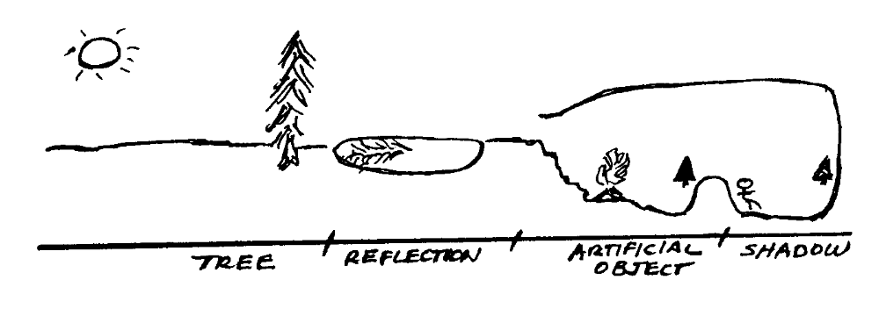
Allegory of the Cave
The allegory of the cave is Plato's attempt to explain how we know what we know.

Slide 37
We are the prisoners who only see the shadows of images on the wall. We think those images are real. We think that they're really tables and chairs and trees, and all the abstract ideas. But they're actually two steps removed from the real thing.

Slide 38
When one person (the philosopher) is released, he can turn around and see that what he thought was real was only shadows of the objects the people were carrying along the wall in front of the fire.

Slide 39
In the case of the tree, you can imagine someone carrying a model of a Christmas tree.
These objects are more 'real' than the shadows but they are not the real objects either. They're just models of the real objects. A ceramic tree, for example.

Slide 40
When the philosopher climbs out of the cave, he can't look up because the light is too strong but he sees the reflection of the tree in the pond.
Although the image in the pond isn't really the tree either, it's closer because it's the image of the real tree rather than the shadow of a model (an image of an image).

Slide 41
When his eyes finally adjust he can look up and see the actual tree illuminated, not by a fire but by the Sun. Now he finally see a real tree, which is the Form all the images of the tree (the reflection, the model and the shadow) represent, albeit imperfectly.

Slide 42
https://www.youtube.com/watch?v=1RWOpQXTltA

Slide 43
Plato died in 347 B.C., leaving the Academy.
The Academy remained a model for institutions of higher learning until Emperor Justinian closed it.

Slide 44
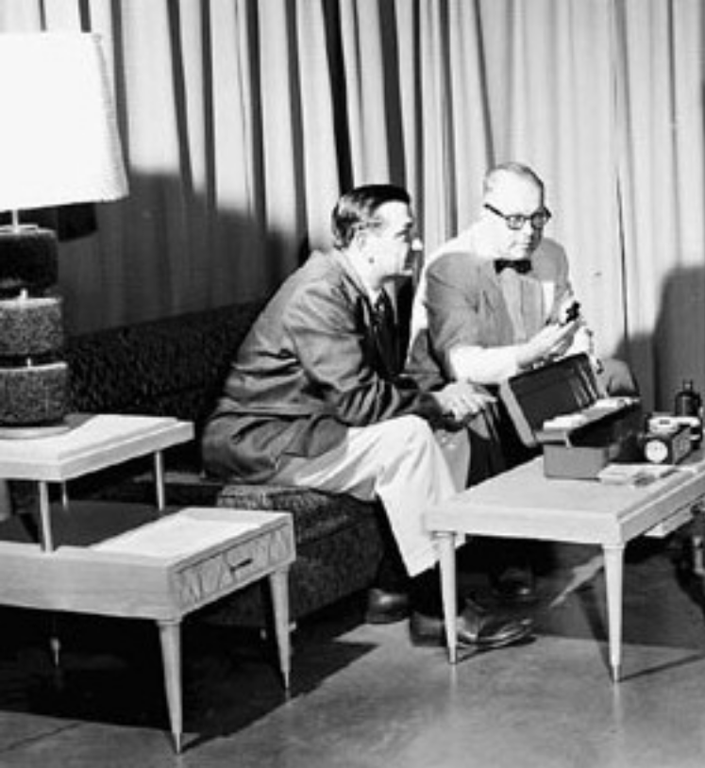
Today’s Cave

Slide 45
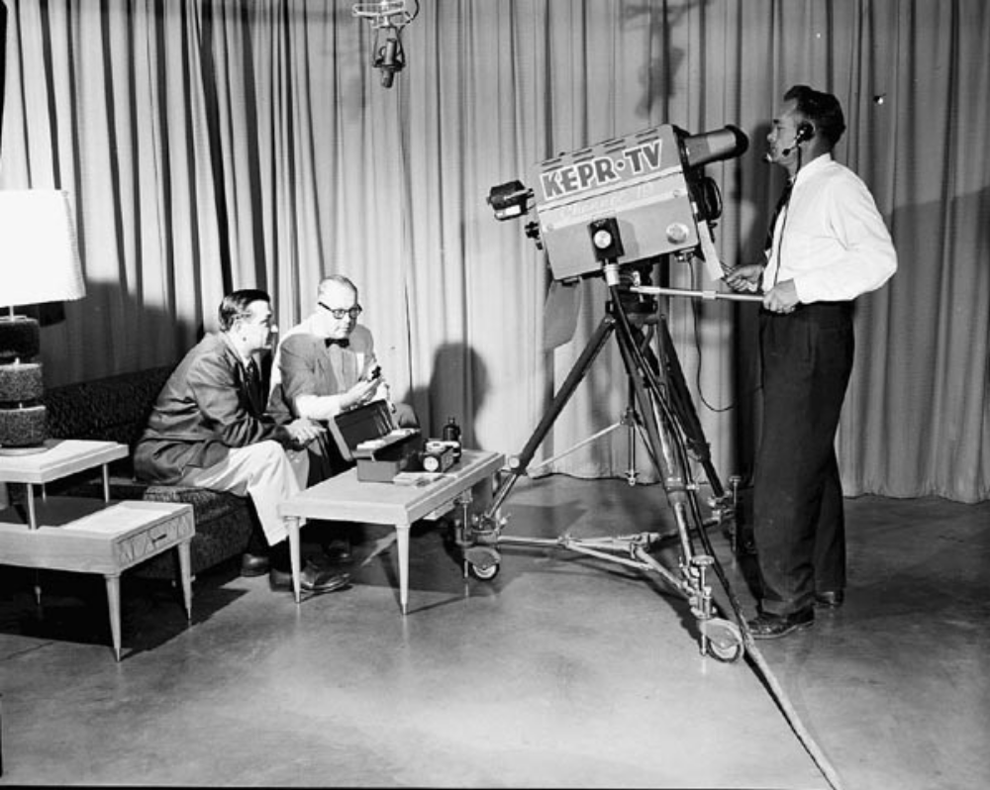
Today’s Cave

